Slide 1
COSC3503 Operating Systems Chapter 6 CPU Scheduling
Doug Lim

Slide 2
Chapter 6 CPU Scheduling
To introduce CPU scheduling, which is the basis for multi-programmed operating systems
To describe various CPU-scheduling algorithms
To discuss evaluation criteria for selecting a CPU-scheduling algorithm for systems
To examine the scheduling algorithms of several operating systems

Slide 3
CPU and I/O Burst Cycles
Maximum CPU utilization obtained with multiprogramming
CPU–I/O Burst Cycle – Process execution consists of a cycle of CPU execution and I/O wait
CPU burst followed by I/O burst
CPU burst distribution is of main concern

Slide 4
CPU Scheduler
Short-term scheduler selects from among the processes in ready queue, and allocates the CPU to one of them
Queue may be ordered in various ways
CPU scheduling decisions may take place when a process:
1. Switches from running to waiting state
2. Switches from running to ready state
3. Switches from waiting to ready
Terminates
Scheduling under 1 and 4 is nonpreemptive
All other scheduling is preemptive
Consider access to shared data
Consider preemption while in kernel mode
Consider interrupts occurring during crucial OS activities
Notes:
CPU State Transitions
Because of an I/O request or the invocation of a wait().
Interrupt occurs moves us from running to ready.
I/O complete / a signal.
Process is complete.
Preemptive
Synchronization was talked about in chapter 5.
Non-preemptive in kernel mode is one solution.
Disable interrupts when operating on data structures used by the interrupts.

Slide 5
Dispatcher
Dispatcher module gives control of the CPU to the process selected by the short-term scheduler; this involves:
switching context
switching to user mode
jumping to the proper location in the user program to restart that program
Dispatch latency – time it takes for the dispatcher to stop one process and start another running

Slide 6
Scheduling Criteria
CPU utilization – keep the CPU as busy as possible
Throughput – # of processes that complete their execution per time unit
Turnaround time – amount of time to execute a particular process
Waiting time – amount of time a process has been waiting in the ready queue
Response time – amount of time it takes from when a request was submitted until the first response is produced, not full output (for time-sharing environment)

Slide 7
First- Come, First-Served (FCFS) Scheduling
Process Burst Time
P₁ 24
P₂ 3
P₃ 3
Suppose that the processes arrive in the order: P₁ , P₂ , P₃ The Gantt Chart for the schedule is:
Waiting time for P₁ = 0; P₂ = 24; P₃ = 27
Average waiting time: (0 + 24 + 27)/3 = 17

Slide 8
Shortest-Job-First (SJF) Scheduling
Associate with each process the length of its next CPU burst
Use these lengths to schedule the process with the shortest time
SJF is optimal – gives minimum average waiting time for a given set of processes
The difficulty is knowing the length of the next CPU request
Could ask the user

Slide 9
Determining Length of Next CPU Burst
Can only estimate the length – should be similar to the previous one
Then pick process with shortest predicted next CPU burst
Can be done by using the length of previous CPU bursts, using exponential averaging
Commonly, α set to ½
Preemptive version called shortest-remaining-time-first

Slide 10
Priority Scheduling
A priority number (integer) is associated with each process
The CPU is allocated to the process with the highest priority (smallest integer = highest priority)
Preemptive
Non-preemptive
SJF is priority scheduling where priority is the inverse of predicted next CPU burst time
Problem: Starvation – low priority processes may never execute
Solution: Aging – as time progresses increase the priority of the process

Slide 11
Round Robin (RR)
Each process gets a small unit of CPU time (time quantum q), usually 10-100 milliseconds. After this time has elapsed, the process is preempted and added to the end of the ready queue.
If there are n processes in the ready queue and the time quantum is q, then each process gets 1/n of the CPU time in chunks of at most q time units at once. No process waits more than (n-1)q time units.
Timer interrupts every quantum to schedule next process
Performance
q large ⇒ FIFO
q small ⇒ q must be large with respect to context switch, otherwise overhead is too high

Slide 12
Example of RR with Time Quantum = 4
Process Burst Time
P₁ 24
P₂ 3
P₃ 3
The Gantt chart is:
Typically, higher average turnaround than SJF, but better response
q should be large compared to context switch time
q usually 10ms to 100ms, context switch < 10 usec

Slide 13
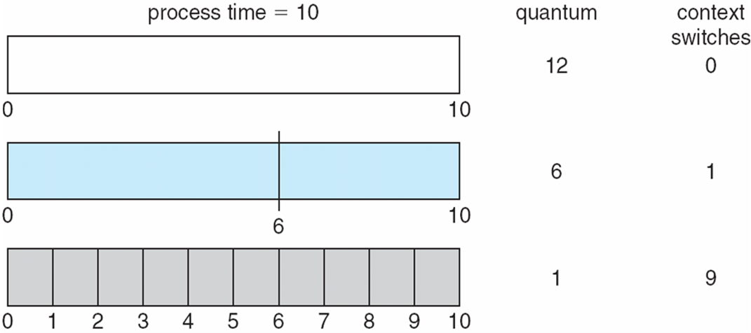
Time Quantum and Context Switch Time

Slide 14
Multilevel Queue
Ready queue is partitioned into separate queues, eg:
foreground (interactive)
background (batch)
Process permanently in a given queue
Each queue has its own scheduling algorithm:
foreground – RR
background – FCFS
Scheduling must be done between the queues:
Fixed priority scheduling; (i.e., serve all from foreground then from background). Possibility of starvation.
Time slice – each queue gets a certain amount of CPU time which it can schedule amongst its processes; i.e., 80% to foreground in RR
20% to background in FCFS

Slide 15
Multilevel Feedback Queue
A process can move between the various queues; aging can be implemented this way
Multilevel-feedback-queue scheduler defined by the following parameters:
number of queues
scheduling algorithms for each queue
method used to determine when to upgrade a process
method used to determine when to demote a process
method used to determine which queue a process will enter when that process needs service

Slide 16
Thread Scheduling
Distinction between user-level and kernel-level threads
When threads supported, threads scheduled, not processes
Many-to-one and many-to-many models, thread library schedules user-level threads to run on Light Weight Process (LWP)
Known as process-contention scope (PCS) since scheduling competition is within the process
Typically done via priority set by programmer
Kernel thread scheduled onto available CPU is system-contention scope (SCS) – competition among all threads in system
Notes:
User-level threads are managed by a thread library and the kernel is unaware of them.
User-level threads must ultimately be mapped to a kernel-level thread to run on a CPU.
Many-to-many and many-to-one the thread library schedules user-level threads to run on an available Light Weight Process(LWP).

Slide 17
Pthread Scheduling
API allows specifying either PCS or SCS during thread creation
PTHREAD_SCOPE_PROCESS schedules threads using PCS scheduling
PTHREAD_SCOPE_SYSTEM schedules threads using SCS scheduling
Can be limited by OS – Linux and Mac OS X only allow PTHREAD_SCOPE_SYSTEM

Slide 18
Multiple-Processor Scheduling
CPU scheduling more complex when multiple CPUs are available
Homogeneous processors within a multiprocessor
Asymmetric multiprocessing – only one processor accesses the system data structures, alleviating the need for data sharing
Symmetric multiprocessing (SMP) – each processor is self-scheduling, all processes in common ready queue, or each has its own private queue of ready processes
Currently, most common
Processor affinity – process has affinity for processor on which it is currently running
soft affinity
hard affinity
Variations including processor sets

Slide 19
Non-Uniform Memory Access (NUMA) and CPU Scheduling

Slide 20
Multiple-Processor Scheduling – Load Balancing
If SMP, need to keep all CPUs loaded for efficiency
Load balancing attempts to keep workload evenly distributed
Push migration – periodic task checks load on each processor, and if found pushes task from overloaded CPU to other CPUs
Pull migration – idle processors pulls waiting task from busy processor
Notes:
Only applies if each CPU has its own Ready Queue.
Sometime Push and Pull can be done in parallel.

Slide 21
Multicore Processors
Recent trend to place multiple processor cores on same physical chip
Faster and consumes less power
Multiple threads per core also growing
Takes advantage of memory stall to make progress on another thread while memory retrieve happens

Slide 22
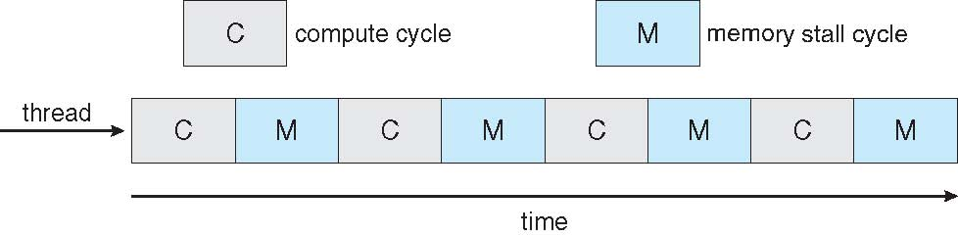

Multithreaded Multicore System

Slide 23
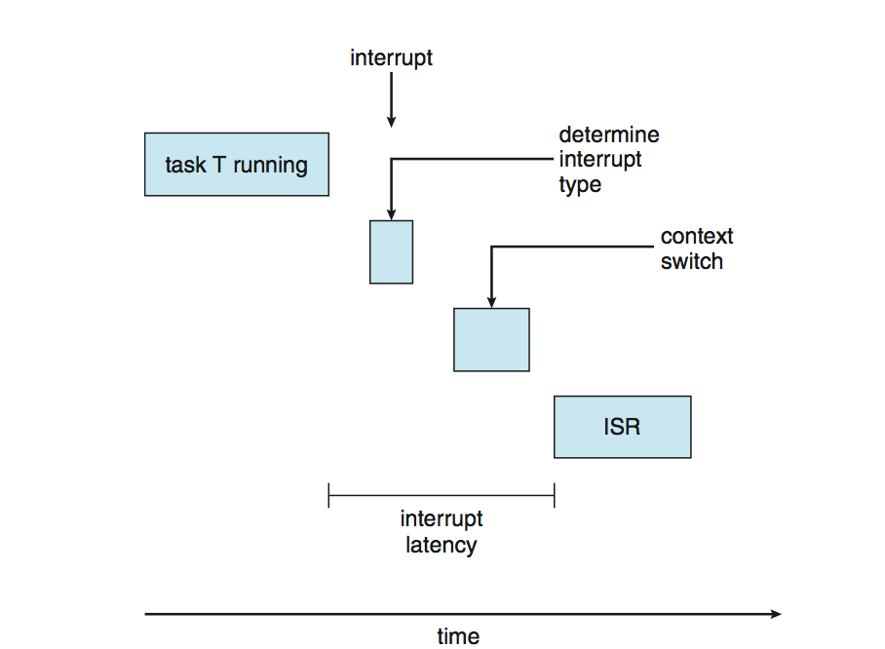
Real-Time CPU Scheduling
Can present obvious challenges
Soft real-time systems – no guarantee as to when critical real-time process will be scheduled
Hard real-time systems – task must be serviced by its deadline
Two types of latencies affect performance
Interrupt latency – time from arrival of interrupt to start of routine that services interrupt
Dispatch latency – time for schedule to take current process off CPU and switch to another

Slide 24
Dispatch Latency
Conflict phase of dispatch latency:
Preemption of any process running in kernel mode
Release by low-priority process of resources needed by high-priority processes
Notes:
Solaris with preemption disable has a dispatch latency of > 100 ms, but with preemption enabled it is reduced to < 1 millisecond.

Slide 25
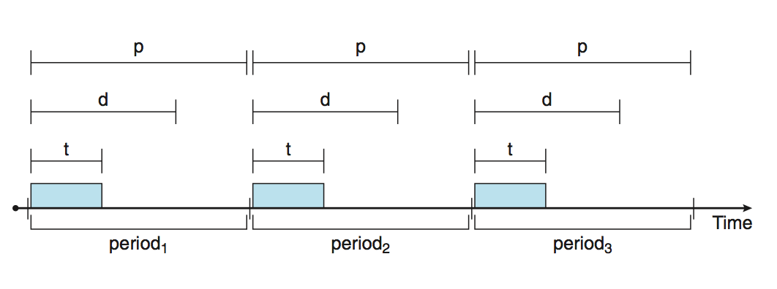
Priority-based Scheduling
For real-time scheduling, scheduler must support preemptive, priority-based scheduling
But only guarantees soft real-time
For hard real-time must also provide ability to meet deadlines
Processes have new characteristics: periodic ones require CPU at constant intervals
Has processing time t, deadline d, period p
0 ≤ t ≤ d ≤ p
Rate of periodic task is 1/p

Slide 26
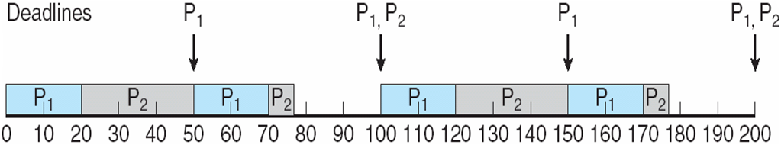
Rate Montonic Scheduling
A priority is assigned based on the inverse of its period
Shorter periods = higher priority;
Longer periods = lower priority
P1 is assigned a higher priority than P2.
Notes:
Rate –monotonic scheduling is considered optimal in that if a set of processes cannot be scheduled by this algorithm, it cannot be scheduled by an other algorithm that assigns static priorities.
Limitation is CPU utilization is bounded. Utilization goes down as the number of processes go up. 2 = 83%, 69% as the number of processes reach infinity.

Slide 27
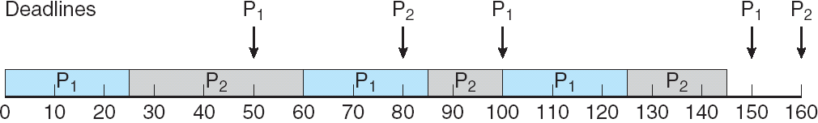
Earliest Deadline First Scheduling (EDF)
Priorities are assigned according to deadlines: the earlier the deadline, the higher the priority; the later the deadline, the lower the priority
Notes:
Theoretically optimal for meeting deadlines. However still limited in CPU usage due to context switching and interrupt handling.
Text also discusses Proportional Share Scheduling and POSIX Real-Time Scheduling.
Also discuss methods of evaluating scheduling algorithms. Simulations tend to be the most accurate.
Implementation is the most accurate, but costly to do.

